Slide 1

Academic Year 2024 - 25 S5 MINI PROJECT - I Second Review
PROJECT TITLE
GROWBRIDGE – A PLATFORM FOR CONNECTING STARTUPS AND INVESTORS
BIP PROJECT ID
8294
CATERGORY
INTERNAL
BATCH MEMBERS
SARVESH S(7376221CS299)
KALAIVANI K(7376221CS183)
GOKUL SREE R(7376221CS154)
NAREN SHANKAR N(7376221CS239)
GUIDE
Dr GANAGAVALLI
Associate Professor
Department of Computer Science Engineering

Slide 2
AIM & OBJECTIVES OF THE PROJECT (Problem Statement)
Aim: To develop an intelligent platform that bridges the gap between startups and investors using AI-powered recommendations.
Objectives:
Design a centralized system to connect investors and startups.
Implement a content-based filtering recommendation engine to suggest suitable matches.
Enable smooth communication through a secure messaging system.
Enhance discoverability and visibility of startups based on investor preferences

Slide 3
LITERATURE SURVEY
Sl.No. | Journal Paper Title with Author | Works carried out ( with details of Methods/ Materials/ Software/ Algorithms / fabrication / techniques/ components used ) | Information gathered relevant to your project
1 | A. Bedi, K. Toshniwal, “A hybrid recommendation system for investors and startups using machine learning techniques,” International Journal of Computer Applications, vol. 178, no. 7, pp. 10–15, May 2019. | Implemented a hybrid recommendation model combining content-based filtering and collaborative filtering using Python and scikit-learn. User profiling was done based on industry, funding stage, and investment preference. | Helped in understanding how to build a personalized matchmaking engine using ML for startup-investor platforms. Inspired the content-based filtering used in Grow Bridge.
2 | S. Patel, V. Khanna, “Investor-Startup matching using NLP-based profiling,” IEEE Access, vol. 9, pp. 102345–102356, 2021. | Used Natural Language Processing (NLP) techniques to extract key features from startup descriptions and investor bios using spaCy and NLTK. | Inspired future enhancement plans for Grow Bridge’s NLP-based matching and profile enrichment.

Slide 4
LITERATURE SURVEY
Sl.No. | References ( Journal Papers Only) | Works carried out ( with details of Methods/ Materials/ Software/ Algorithms / fabrication / techniques/ components used ) | Information gathered relevant to your project
3 | J. Singh, R. Sharma, “Designing scalable startup platforms using PostgreSQL and Django,” Journal of Software Engineering, vol. 14, no. 2, pp. 55–63, Mar. 2020. | Focused on database modeling and optimization using PostgreSQL with relational schema for startup ecosystems. | Helped in designing the PostgreSQL schema for users, connections, and recommendation logs in Grow Bridge
4 | M. Kaur, A. Mehta, “Scalable frontend architecture using React and Next.js,” International Journal of Web & Semantic Tech (IJWesT), vol. 12, no. 3, pp. 45–53, Sept 2021. | Focused on building modular, SEO-friendly UI with React and Next.js. Included SSR and API route integration. | Guided the frontend architecture decisions for building Grow Bridge with modular design and Next.js features.

Slide 5
SCOPE OF THE PROJECT
The platform focuses on bridging the gap between early-stage startups seeking capital and investors looking for relevant, high-growth opportunities.
Allows role-based user onboarding, where startups and investors input structured data including domains, funding stage, location, and interests.
Utilizes a content-based recommendation algorithm that calculates similarity scores between startup and investor profiles using textual features and filters.
Supports automated investor suggestions for startups and vice versa, improving efficiency over manual searches.

Slide 6
NEED FOR THE CURRENT STUDY
Traditional startup-investor discovery methods are manual, time-consuming, and often inefficient.
Existing platforms lack intelligent matchmaking; they offer static listings without personalization.
Startups struggle to reach relevant investors aligned with their domain, funding stage, and vision.
Investors are overwhelmed by irrelevant proposals, making filtering a challenge.
There is a clear need for an AI-powered platform that automates and personalizes investor-startup connections.
Grow Bridge aims to address this gap using content-based filtering to recommend highly relevant matches and streamline the engagement process.

Slide 7
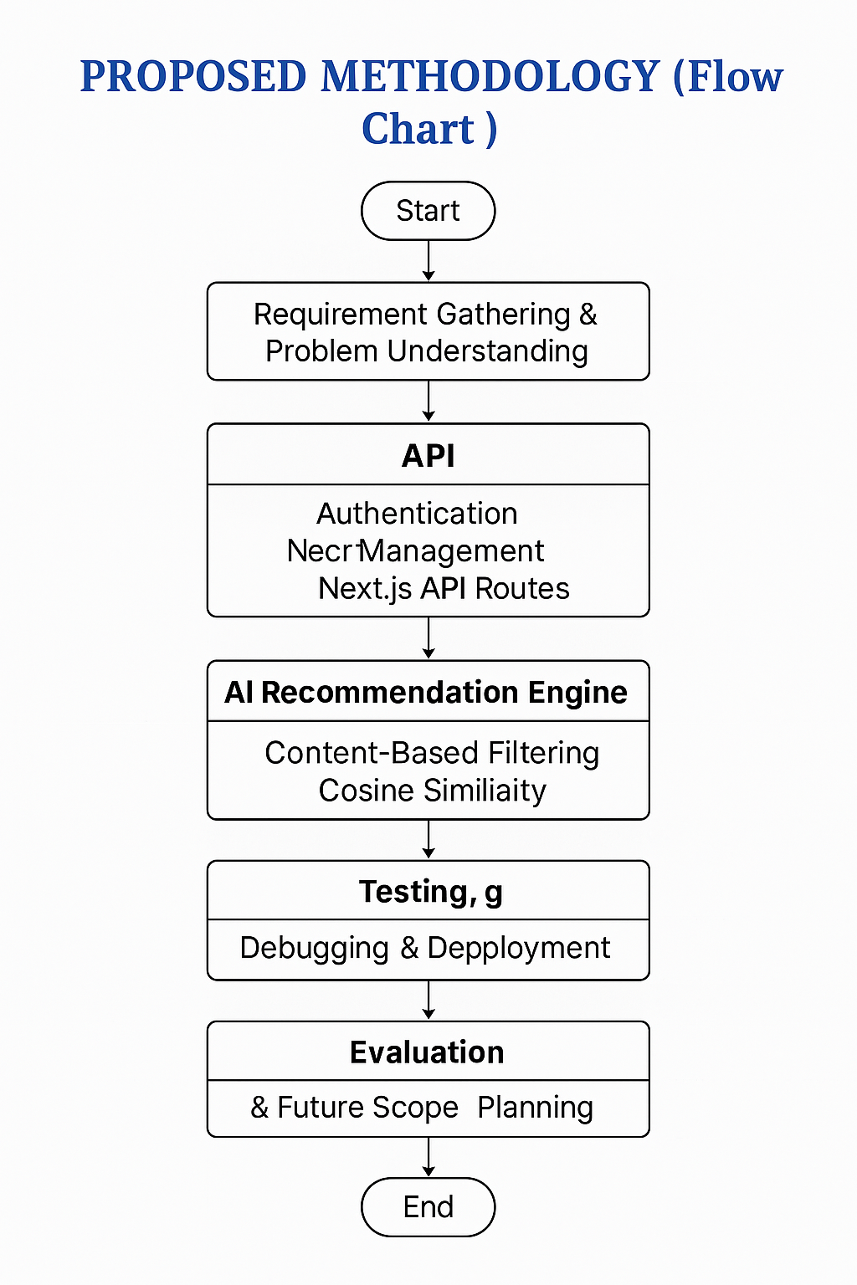

Slide 8
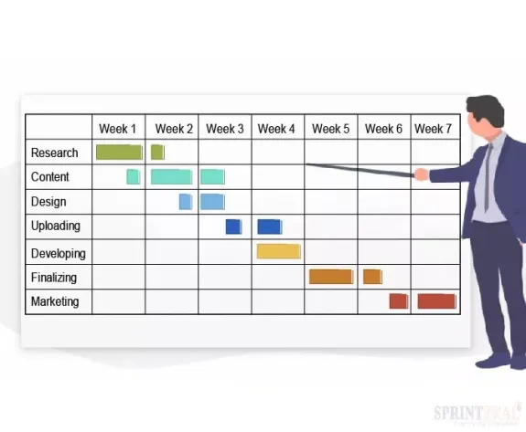
PROPOSED METHODOLOGY ( Gantt Chart)

Slide 9
CHOICE OF COMPONENTS / MODULES / METHODS/TECHNIQUES EQUIPMENT USED FOR PROJECT DEVELOPMENT
Frontend: React.js
Backend: Node.js
Database: PostgreSQL
AI Technique:
Content-based filtering
Modules:
User Authentication
Profile Management
Recommendation System

Slide 10
DESIGN(S) (HARDWARE / SOFTWARE ARCHITECTURE)
Grow Bridge uses a modern full-stack architecture with Next.js for the frontend, providing fast, responsive user interfaces.
The backend is handled via Next.js API routes, managing authentication, user operations, and AI-driven matchmaking.
The recommendation engine uses content-based filtering with TF-IDF and cosine similarity to suggest relevant investor-startup matches.
All data is stored in a PostgreSQL database, including user profiles, messages, and connection logs.

Slide 11
CONCLUSION
Grow Bridge successfully addresses the gap between early-stage startups and potential investors through a smart, AI-powered platform.
The use of content-based filtering ensures precise and relevant startup-investor matches.
Developed with a scalable architecture using Next.js, and PostgreSQL, enabling efficient data handling and future expansion.
Features like real-time messaging, role-based access, and a user-friendly interface enhance engagement and trust.

Slide 12
INDIVIDUAL CONTRIBUTIONS TO THE WORK
Batch Member 1 : ( 7376221CS299 & Sarvesh S )
Developed Next.js API routes to handle user operations, authentication, and messaging.
Connected the backend with PostgreSQL, managing CRUD operations and schema design.
Managed session handling, middleware, and error responses.
Ensured secure data flow and validation across endpoints.
Supported integration of the recommendation engine with backend APIs.

Slide 13
INDIVIDUAL CONTRIBUTIONS TO THE WORK
Batch Member 2 : (736221CS183 & Kalaivani K )
Designed and implemented the AI-based recommendation engine using content-based filtering.
Processed user profiles using TF-IDF and computed cosine similarity scores.
Tuned the model to improve match accuracy between startups and investors.
Integrated the model with the backend to provide real-time suggestions.
Planned future enhancements using NLP for intelligent matchmaking.

Slide 14
INDIVIDUAL CONTRIBUTIONS TO THE WORK
Batch Member 3 : (7376221CS154 & Gokul Sree R )
Designed the PostgreSQL database schema for users, messages, and recommendations.
Set up relational tables with constraints and indexing for performance.
Wrote SQL queries for efficient data retrieval and match tracking.
Connected the database with backend APIs using an ORM (TypeORM).
Handled database testing, optimization, and migrations.

Slide 15
INDIVIDUAL CONTRIBUTIONS TO THE WORK
Batch Member 4 : (7376221CS239 & Naren Shankar N )
Designed and developed the frontend using Next.js.
Created responsive UI components for user dashboard and registration.
Implemented role-based authentication and session management.
Integrated real-time messaging using WebSockets.
Coordinated frontend-backend communication through API calls.

Slide 16
PENDING WORKS AND PLAN FOR COMPLETION
1.API Integration
2.Database Migration
3.Dashboard UI completion

Slide 17
PLAN FOR PUBLICATIONS
Paper Presentation
Completed the presentation through virtual mode in VELLAMAL COLLEGE OF ENGINEERING ON 23.03.2025

Slide 18
Status on Partial Completion and Submission of Project Report
List of Documents to be Submitted
SL.No | List of Documents | Status ( Provide the drive link of prepared document)
1 | Cover Page & Title Page (Both are in same format)
2 | Bonafide Certificate
3 | Declaration
4 | Acknowledgement
5 | Chapter I – Introduction
6 | Chapter 2 – Literature Survey

Slide 19
Submission of Project Report
List of Documents to be Submitted
SL.No | List of Documents | Status ( Provide the drive link of prepared document)
7 | Chapters 3 - Objectives and Methodology
8 | Chapters 4 - Proposed work modules (Chapters name can be based on the work)
9 | Chapter 5 - Results and Discussion
10 | Chapters 6 - Conclusions & Suggestions for Future work
11 | References
12 | Appendices

Slide 20
PUBLICATIONS (CONFERENCE / JOURNAL / PATENT)
SL.No | Paper/Manuscript Title | Status ( Provide the drive link of prepared document)
1
2

Slide 21
ORIGINALITY SCORE
SL.No | Tool name for checking originality score | Status ( Provide the drive link of prepared document)
1
2

Slide 22
Any Other Relevant Details

Slide 23
REFERENCES ( Journal Papers/ Books / Website in IEEE Format )
Journal
[1] A. Bedi and K. Toshniwal, "A hybrid recommendation system for investors and startups using machine learning techniques," International Journal of Computer Applications, vol. 178, no. 7, pp. 10–15, May 2019. [2] S. Patel and V. Khanna, "Investor-startup matching using NLP-based profiling," IEEE Access, vol. 9, pp. 102345–102356, 2021.
Books
[1] R. Agarwal, Data Mining Techniques for Marketing, Sales, and CRM, Wiley, 2021. [2] M. Lutz, Programming Python, 4th ed., O'Reilly Media, 2021.
Patent
[1] J. Smith, “System and method for AI-driven startup-investor matchmaking,” US Patent 10,982,345 B2, Apr. 6, 2021.
Website
[1] M. Sharma, "How AI is transforming startup ecosystems," Forbes Tech Council, https://www.forbes.com/sites/forbestechcouncil/2023/07/10/how-ai-is-transforming-startup-ecosystems/, accessed Mar. 19, 2025.

